Slide 1

Rural Food Processing
6 November 2019
ME 476C - Team Cocoyam
Samantha Morrison - Project Manager
Nygel des Vignes - Financial Manager
Musab Al-Balool - Manufacturing Engineer
Humoud Alanjari - Logistics Manager
Sponsored By:

Slide 2
Outline of Presentation
6 November 2019
Project Description
Design Description and CAD
Design Requirements
FMEA
Testing
Schedule and Budget
Questions
Citations
Rural Food Processing
Al-Balool 2

Slide 3
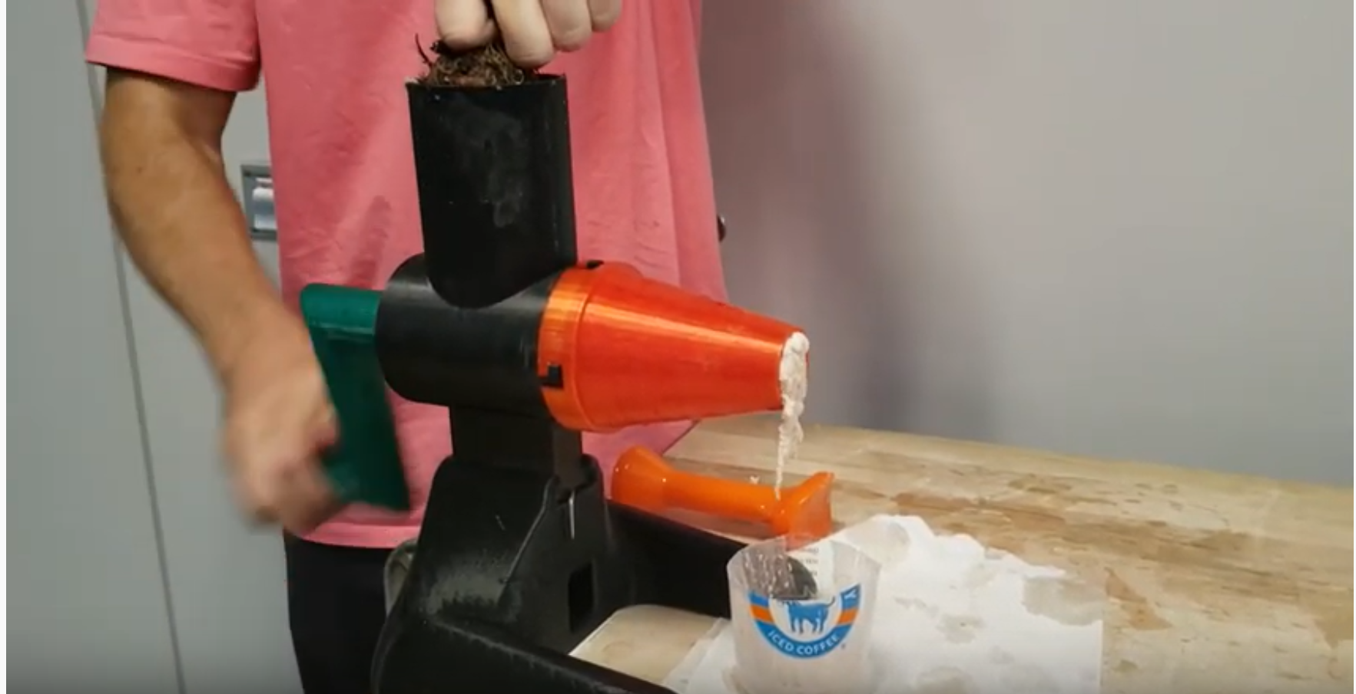

Project Description
6 November 2019
Cocoyam dispenser and roller
Improve upon current hand rolling technique
Help West and Central African Communities
Continue upon Georgia Tech’s grinder
Create a design package that can be transferred and replicated easily
Client- Isaac Zama - Humanitarian
Mentor - Chuck Vallance
Sponsor - W.L. Gore
Figure 1: Manual grinder by Georgia Tech [1]
Figure 2: Raw Cocoyam [2]
Rural Food Processing
Al-Balool 3

Slide 4
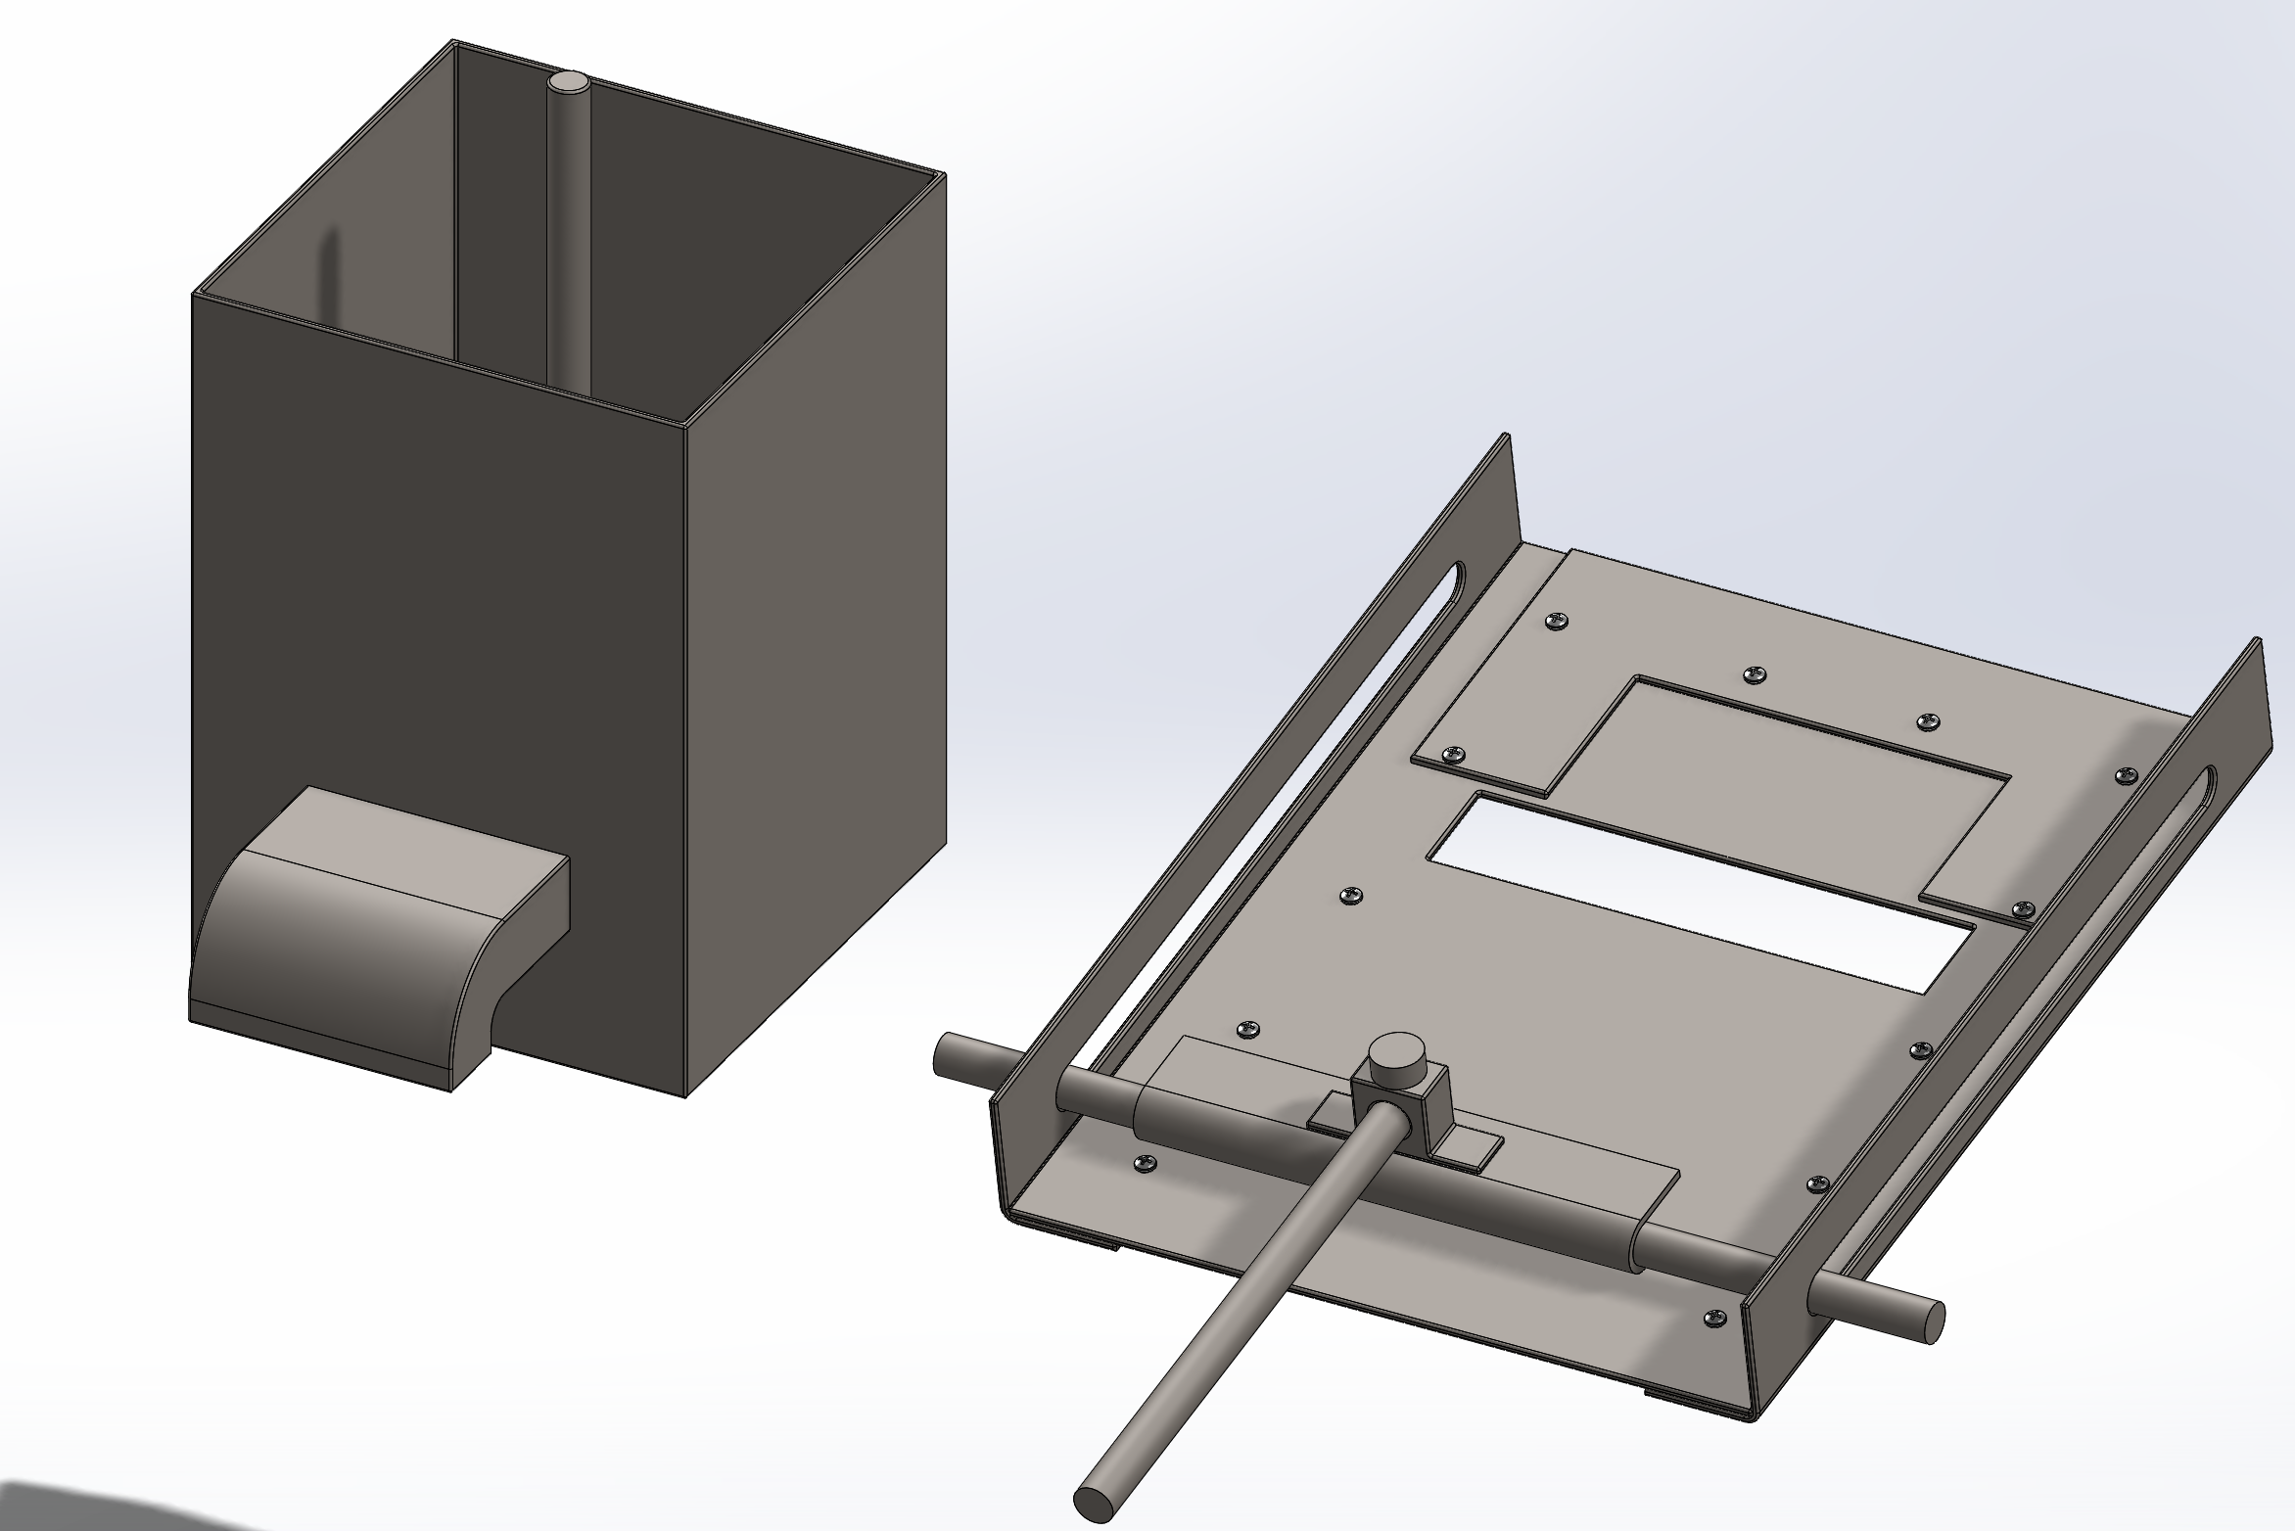
Full CAD
6 November 2019
(1) Reservoir
(2) Dispenser
(3) Rolling Device
Figure 3: Full CAD Model of all subsystems
Rural Food Processing
Morrison 4

Slide 5
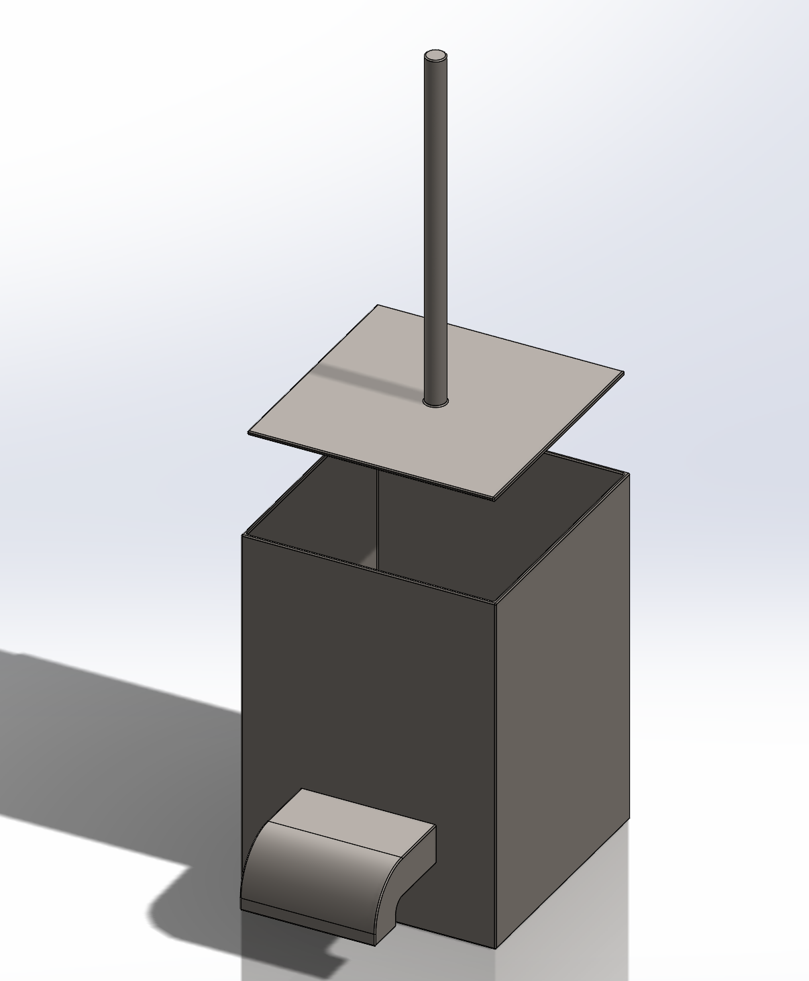
Design Description - Dispenser
6 November 2019
(2)
(3)
Implementation:
  Cocoyam placed into reservoir (1)
  User holds handle of plunger (2)
  User pushes plunger into reservoir (3)
  Cocoyam forced out of nozzle (4)
  Cocoyam dispensed onto leaf held by user (5)
(1)
(4)
(5)
Figure 4: Isometric Dispenser View
Rural Food Processing
Morrison 5

Slide 6
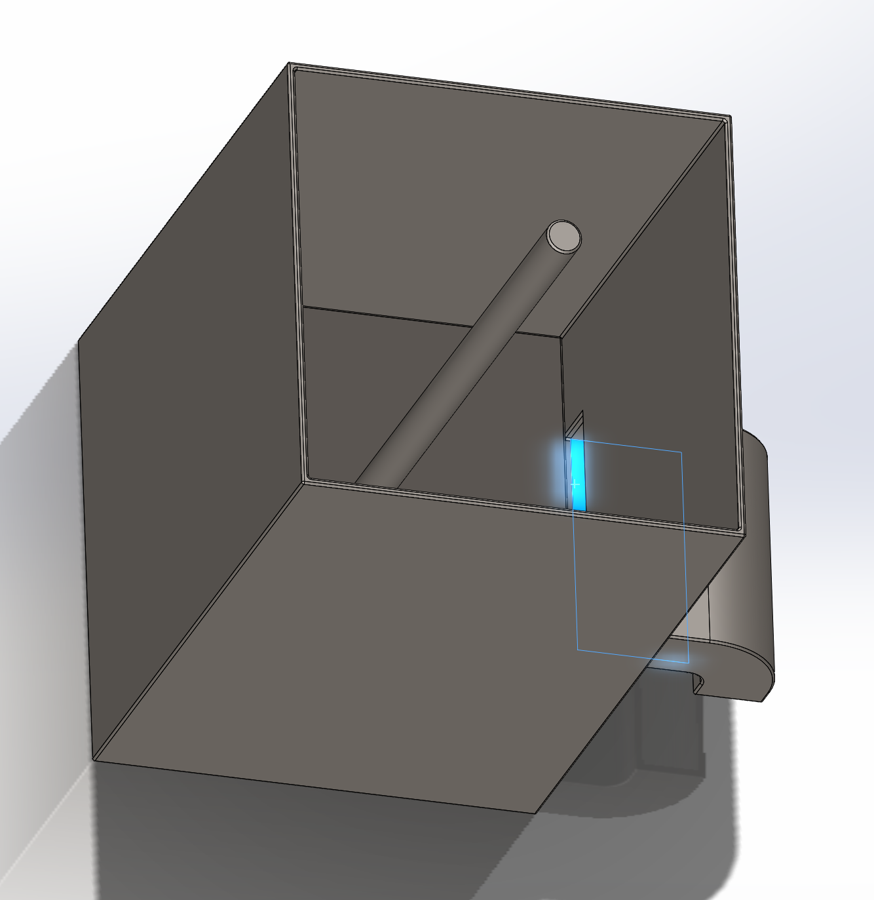
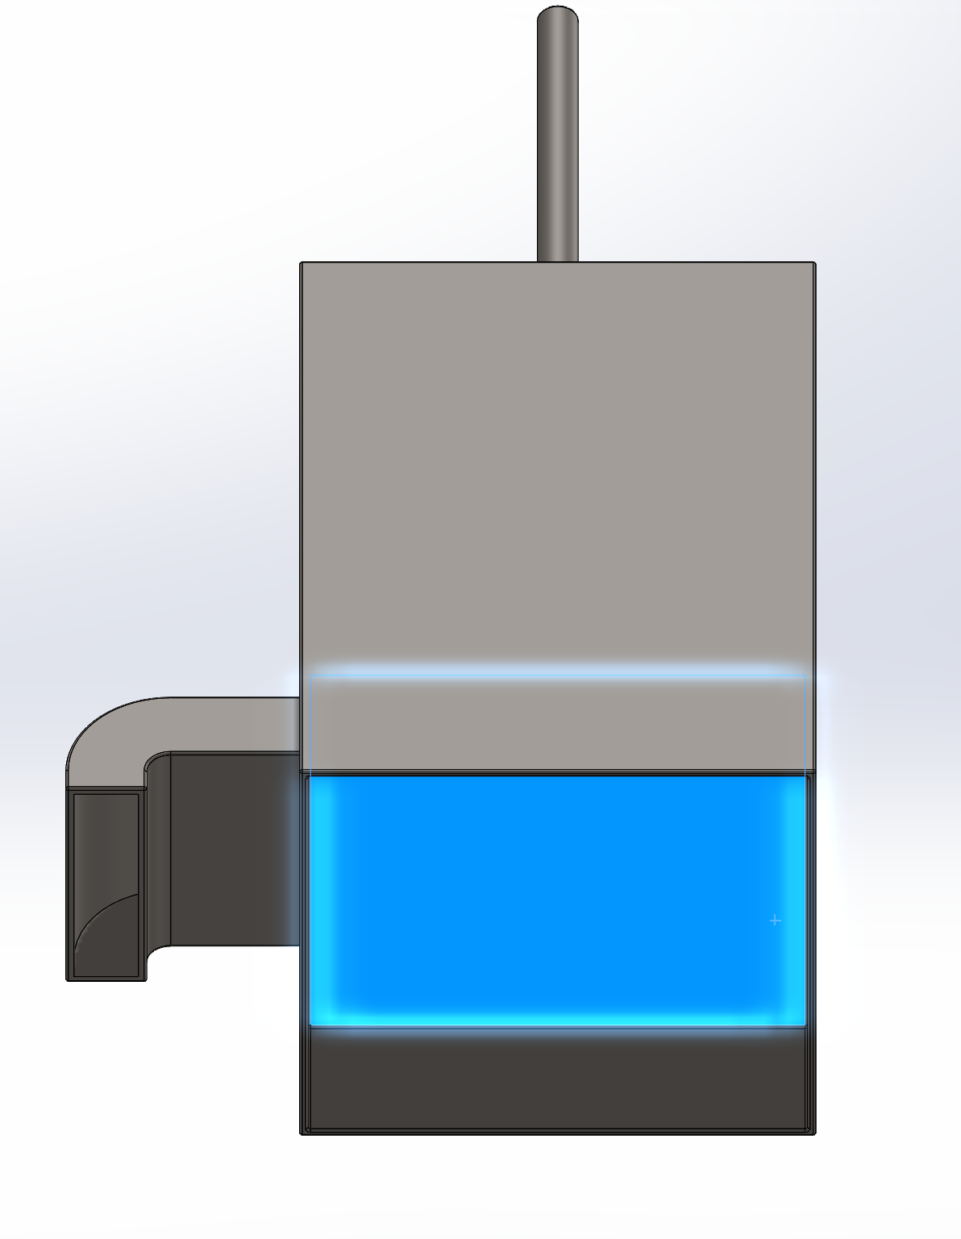
CAD - Dispenser
6 November 2019
Figure 6: Top View - plunger stops at bottom of nozzle inlet (blue)
Figure 5: Bottom View - excess side material acts as risers for reservoir
Rural Food Processing
Morrison 6

Slide 7
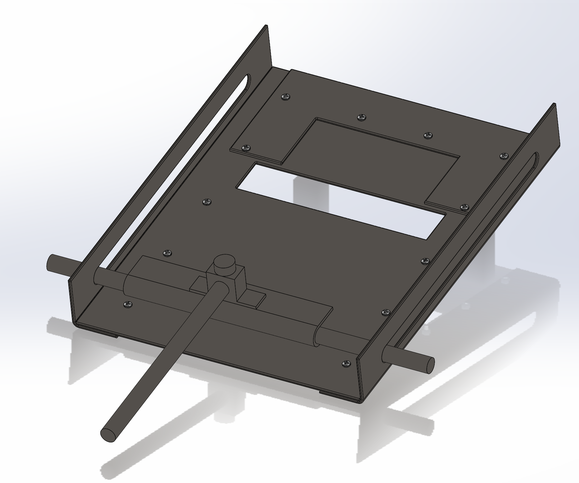
Design Description - Roller
6 November 2019
(3)
Implementation:
  Cocoyam and leaf placed (1)
  User holds handle (2)
  User pushes handle to end of rail (3)
  Cocoyam is rolled and deposited into crevice in base plate (4)
  User pulls handle to start of rail (5)
  User removes rolled Ekwang
(4)
(5)
(1)
(2)
Figure 7: Isometric Roller View
Rural Food Processing
Morrison 7

Slide 8
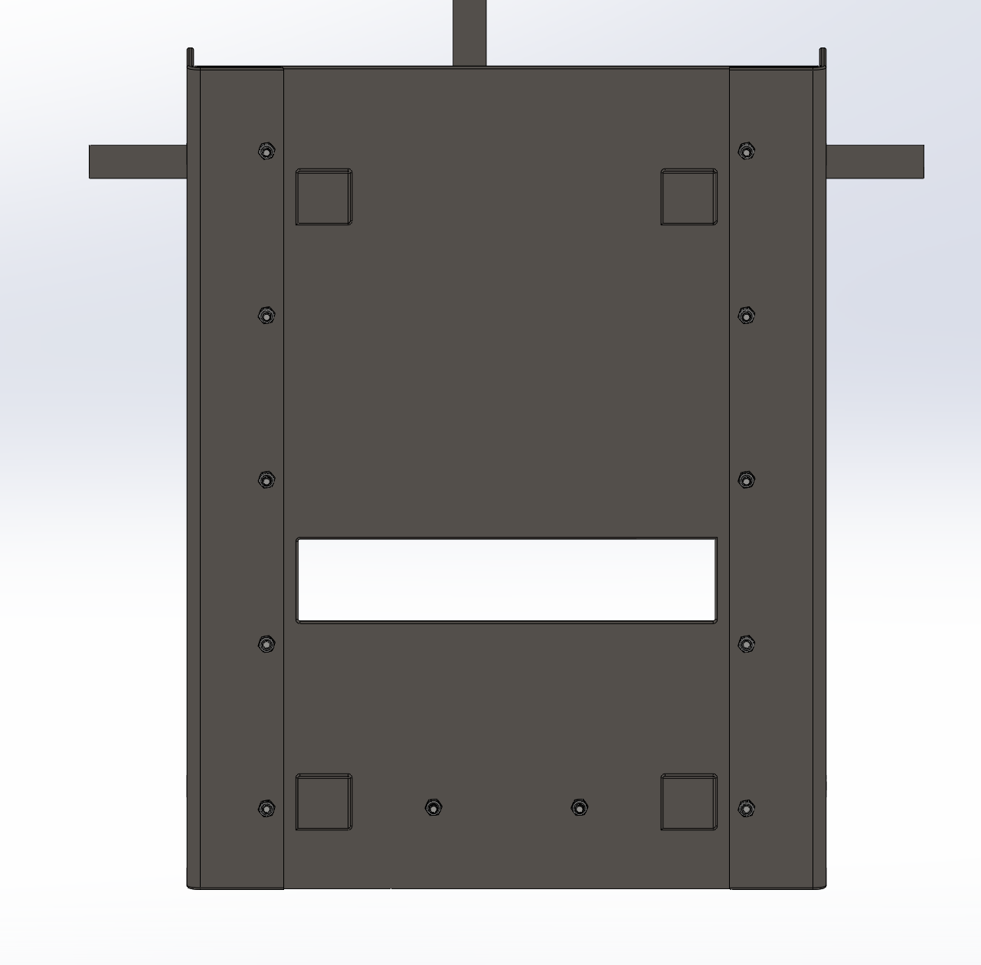
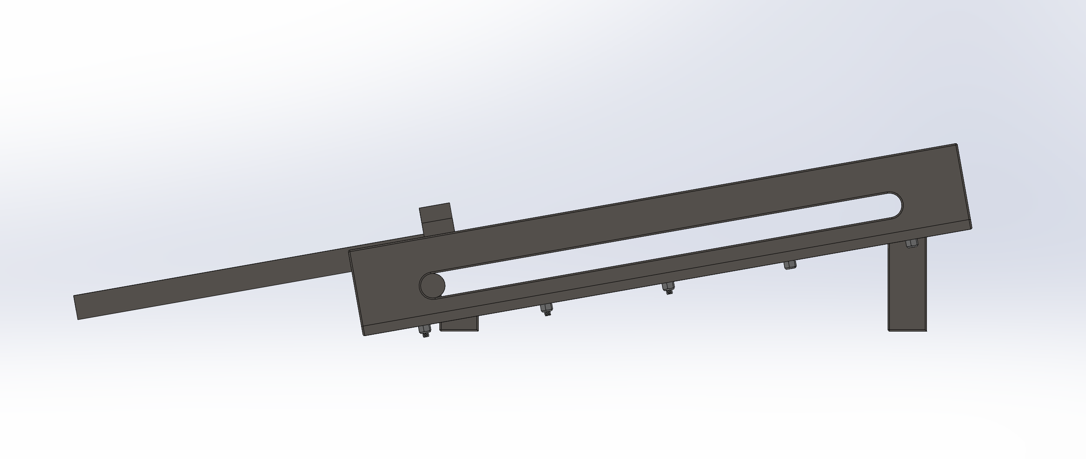
CAD - Roller
6 November 2019
Figure 8: Right Roller View - 10° angle and supported by legs (welded to base)
Figure 9: Bottom Roller View - overlap of hardware secured to base
Rural Food Processing
Morrison 8

Slide 9
Design Requirements-CR
6 November 2019
CRs:
  Reliability
  Durability
  Lightweight
  Safe to use
  Simplicity
  Low cost
  Mobility
  Faster than hand rolling
  Easy to use by anyone
  Adjustable dispensing
Achieved by Design
Mass of the system - 7.22kg
Volume of the system -0.000924m³
Base footprint area - 0.12m²
Radius of edges - 1mm
Center of gravity - (0.105,0.216,0.335)mm
Force to push handle - 2.44lbs
Rural Food Processing
Alanjari 9

Slide 10
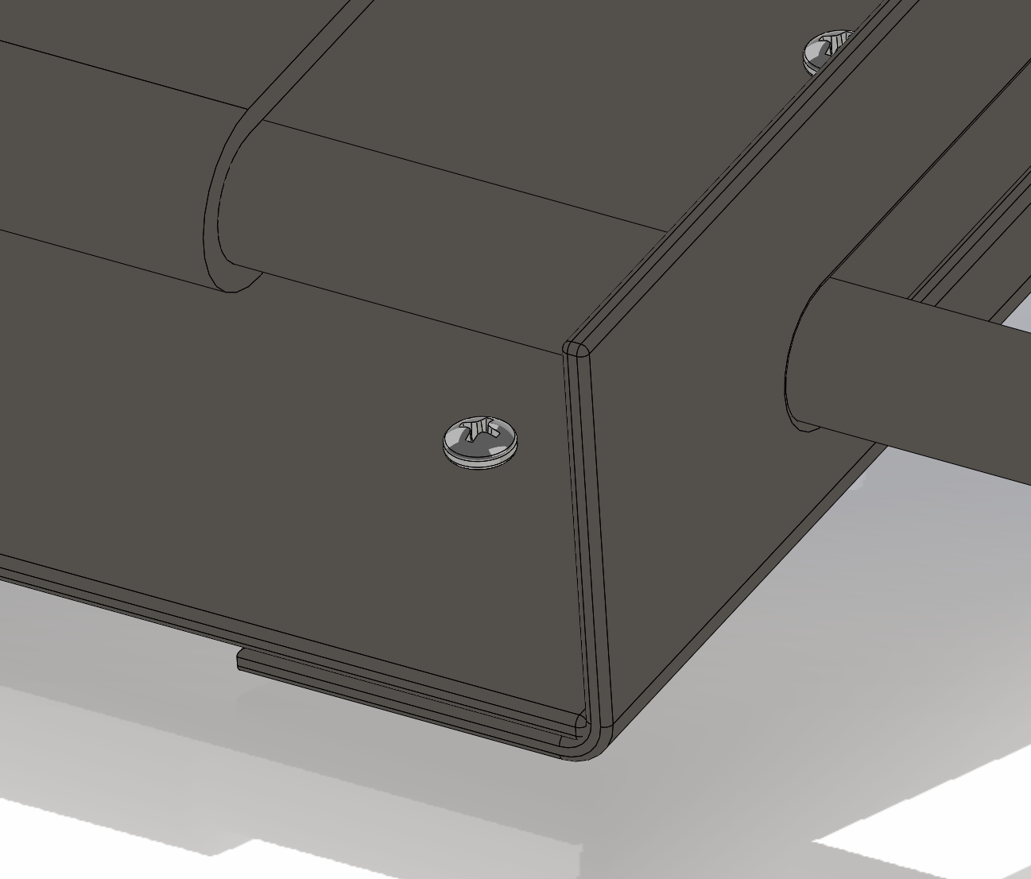
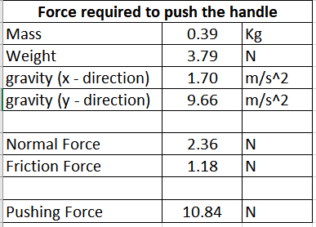
Design Requirements-CR
6 November 2019
Table 1: Force required to push the handle [3].
Figure 10: Rounded edges on all components
Rural Food Processing
Alanjari 10

Slide 11
Design Requirements-ER
6 November 2019
ERs:
  Low cost< 45 dollars
  Minimize the time to produce one role<30 seconds
  Light weight [kg] <7kg
  Base footprint area [m²] < 0.125m²
  Volume of material to create device [m³]<0.02 m³
  Smooth edges [mm] radius<5mm
  Material strength [N/m²]
  Material density [kg/m³]
  Capacity [L]
  Low center of gravity
  Factor of safety
Values Achieved by Design
Mass of the system - 7.22kg
Volume of the system - 0.000924m³
Base footprint area - 0.12m²
Radius of edges - 1mm
Center of gravity at (0.105,0.216,0.335)mm
Force to push handle - 2.44lbs
Rural Food Processing
Des Vignes 11

Slide 12
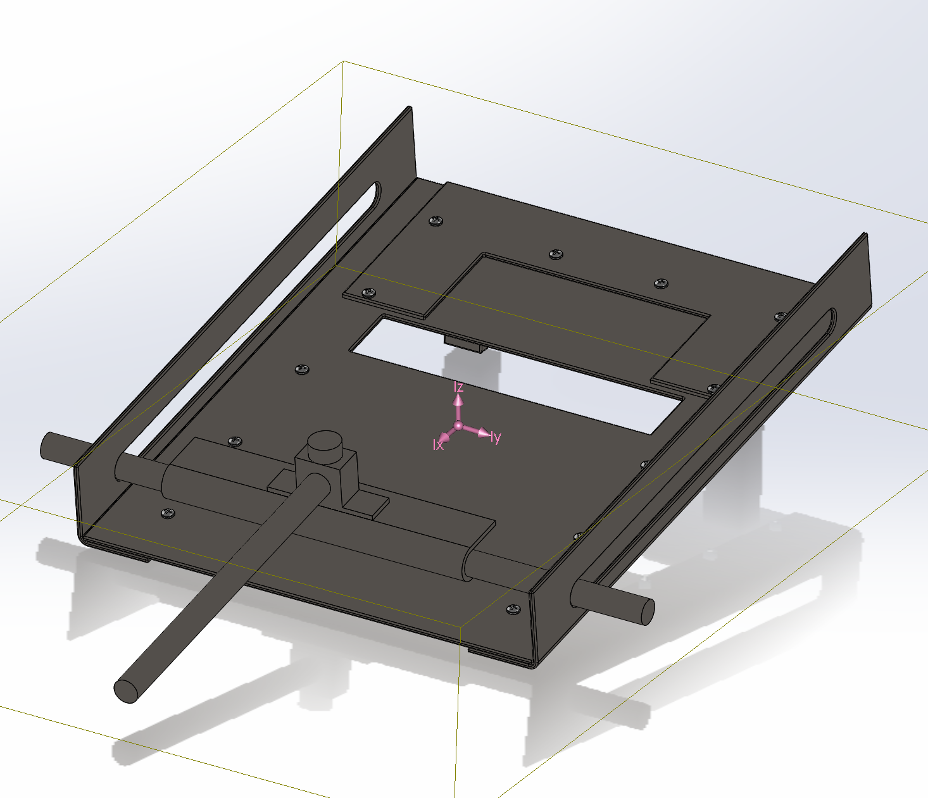
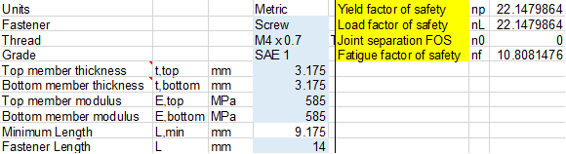
Design Requirements-ER
6 November 2019
Table 2 : Fasteners and Fastener Factor of Safety [4]
Figure 11 : Isometric View - Center of Gravity
Rural Food Processing
Des Vignes 12

Slide 13
FMEA
6 November 2019
Major Potential Failures
Reservoir/ Hopper → Walls coming apart → Weld break
Roller base → Base deformed → Deflection of base
Belt → Belt rips → Inability to roll
Handle → handle breaks → potential harm to user
Recommended Actions to overcome failures
Avoid excessive force (determine typical use and maximum forces expected)
Monitor consistency of product
Fasten joints properly (include explicitly in operations manual)
Rural Food Processing
Al-Balool 13

Slide 14
Risk Trade-Off
6 November 2019
Risk
Choosing stainless steel as the material for the device
Using a slotted rail system
Making dispenser a separate part from the roller
Limiting the size of the reservoir
Trade Offs
Device is heavier but more durable
Increased friction between parts but simpler to manufacture
More physical input needed from user but allows for simpler design and increased stability of dispenser
Needs to be refilled more often but allows for more maneuverability and stability
Rural Food Processing
Des Vignes 14

Slide 15
Testing
6 November 2019
Test
Weight Test - Test ER “ Low Weight” by weighing the device
Durability Test - Test ER “Material Strength” by applying force and observing deflection or failures
Safety Test - Test ER “Smooth Edges” by using a balloon to detect sharp edges
Reliability Test - Test ER “minimize time of one roll” to ensure that device rolls correctly and in less time than hand rolling by hands
Assembly Test - Test ER “Simplicity ” by having individuals assemble the device using the operations manual
Mobility Test - Test CR “Mobility” by having individuals carry the assembly
Resources
Scale
Weights
Timer
Measuring Tape
Volunteers (mobility/assembly test)
Balloon
Rural Food Processing
Alanjari 15

Slide 16
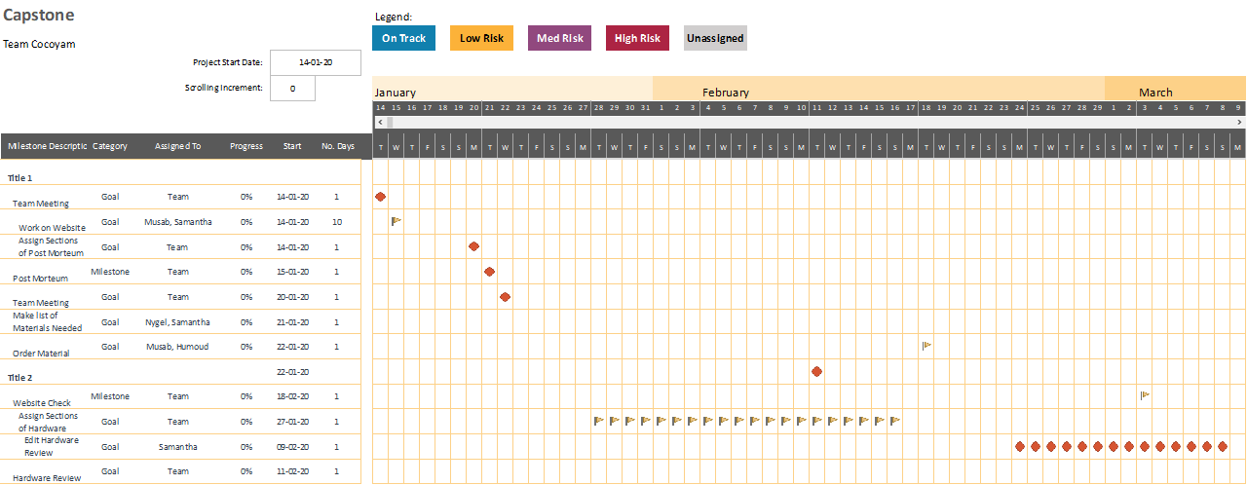
Schedule
6 November 2019
Figure 12: Second Semester Capstone Gantt
Rural Food Processing
Morrison 16

Slide 17
Budget
6 November 2019
Total Budget: $1500
Initial prototype materials: $41.63
Remaining Budget: $1,458.37‬
  Future Prototyping: $500.00
  Testing: $200.00
  Final Design (and any iterations): $200.00
Rural Food Processing
Morrison 17

Slide 18
Questions?
6 November 2019
Rural Food Processing
18

Slide 19
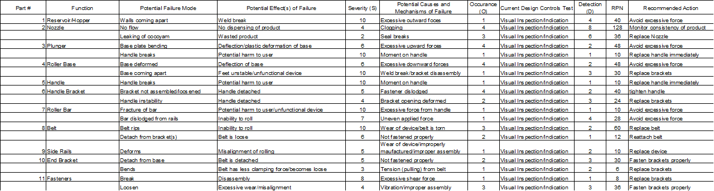
Appendix A - FMEA
6 November 2019
Rural Food Processing
19

Slide 20
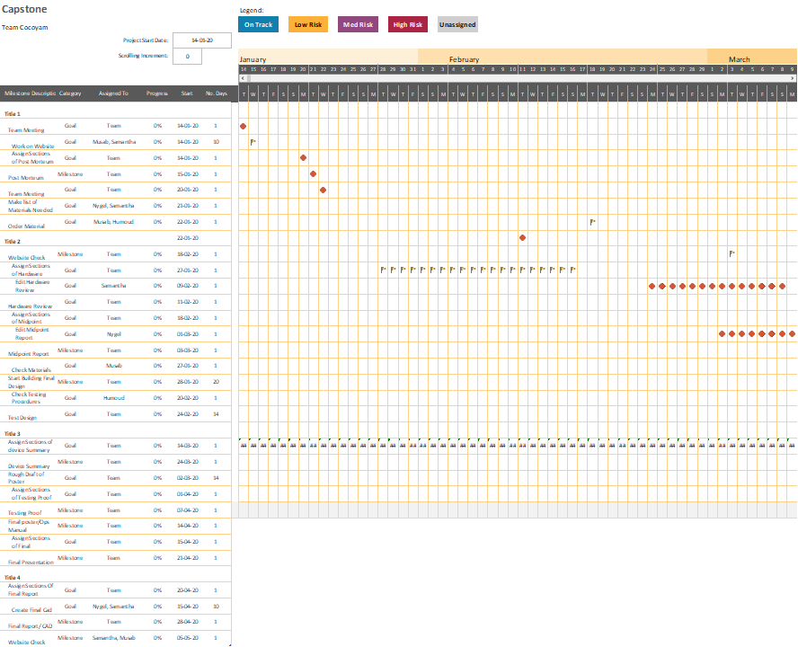
Appendix B - Schedule
Rural Food Processing
20

Slide 21
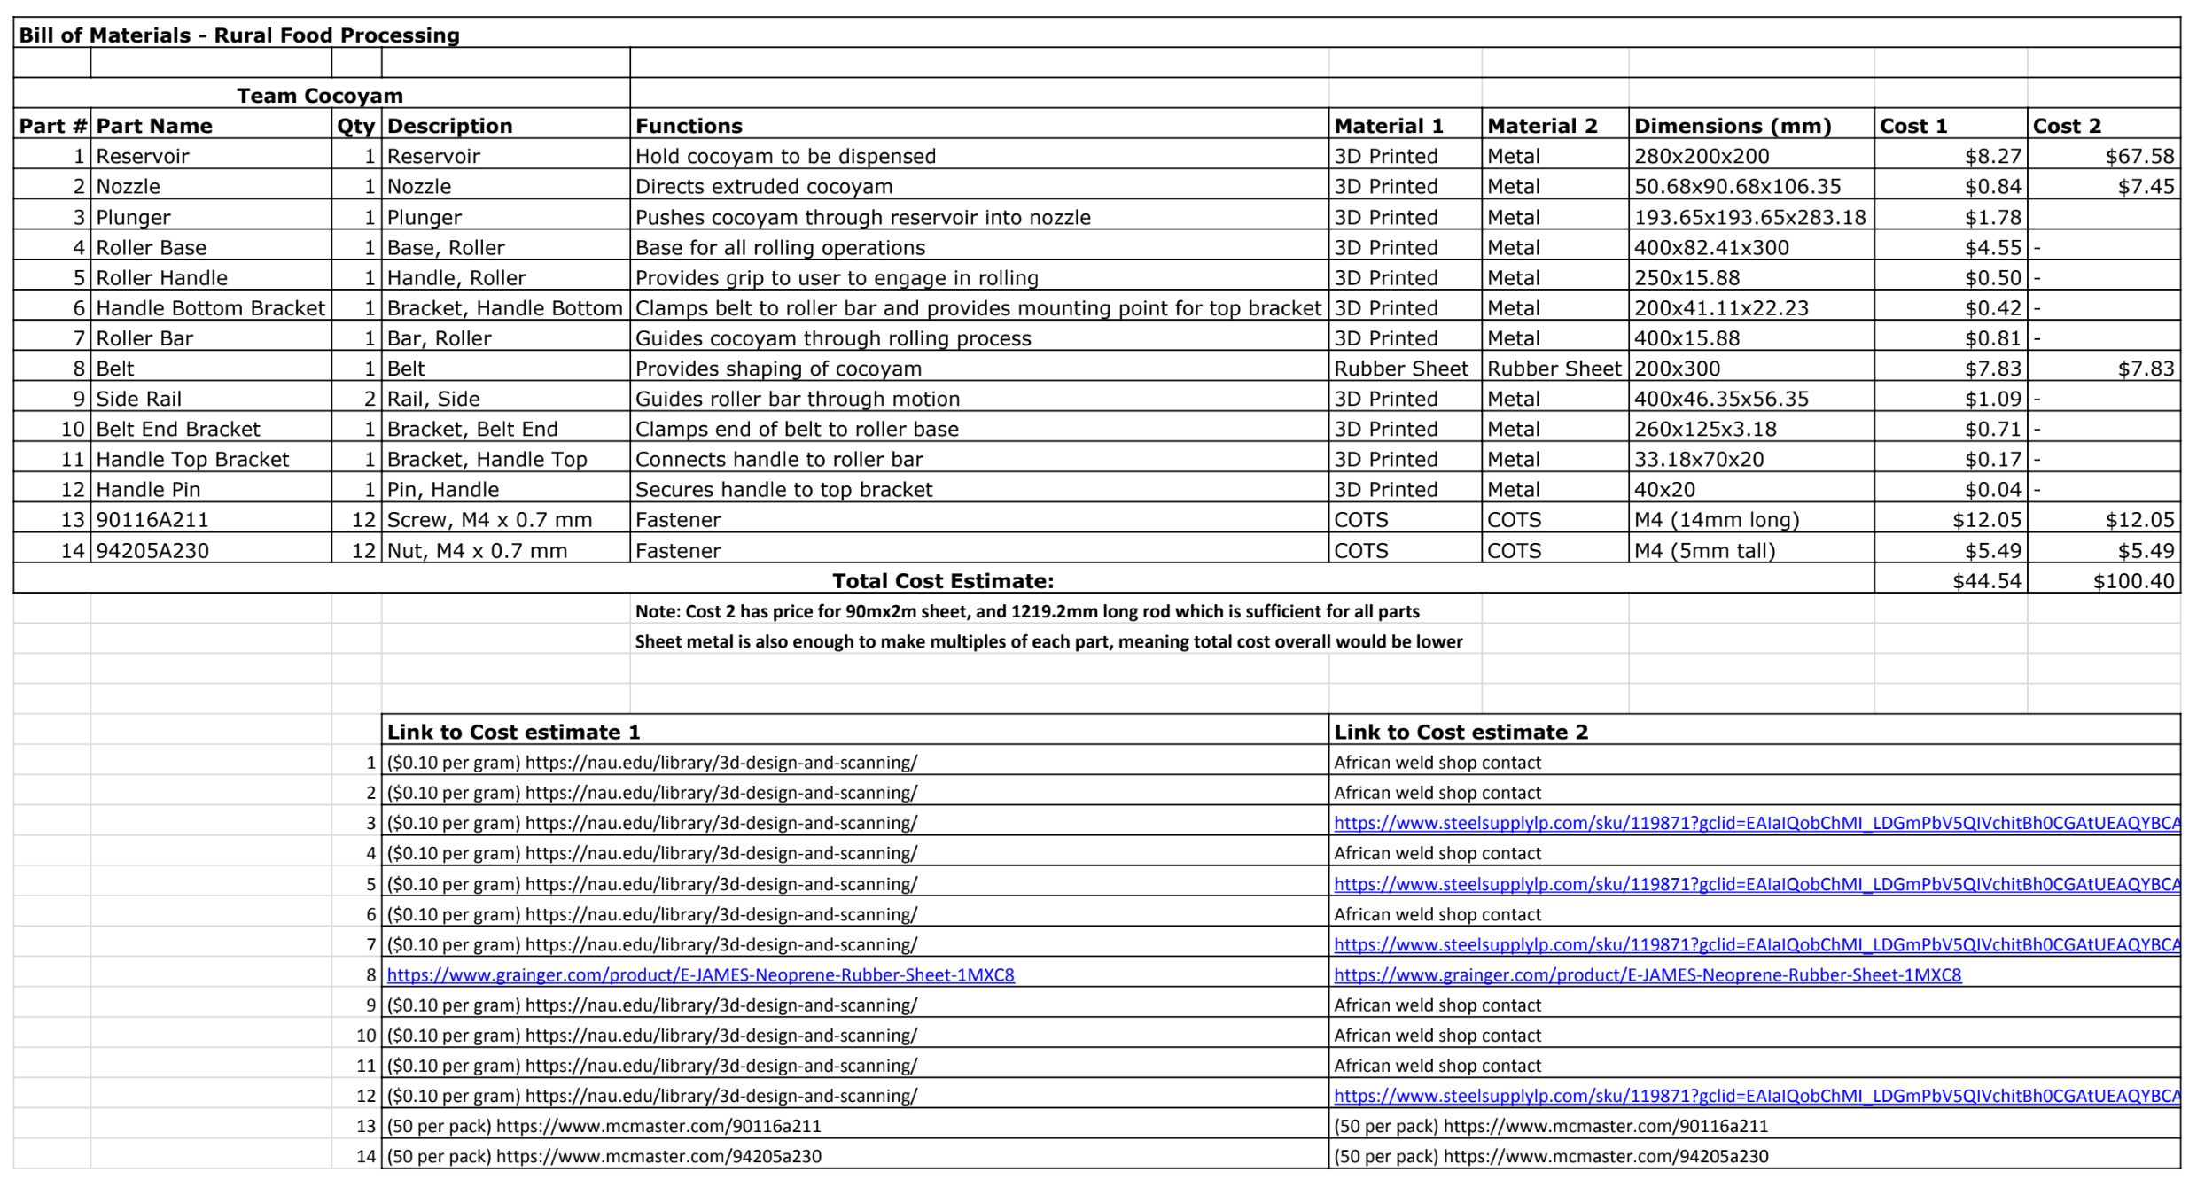
Appendix C - BOM
Rural Food Processing
21

Slide 22
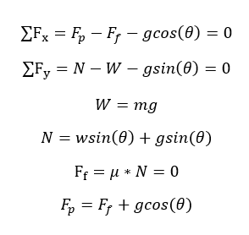
Appendix D - Force to push handle equations
Rural Food Processing
22

Slide 23
Citations
6 November 2019
[1] Evan Williamson, “Coco-YUM! - The manual cocoyam processor,” YouTube, 23-Jul-2019. [Online]. Available: https://www.youtube.com/watch?v=siXvcSSyxC4#action=share. [Accessed: 15-Sep-2019].
[2] Admin, “Health Benefits and Nutrition of Taro Root,” TAROTO TAIWANESE HEALTHY DESSERT. [Online]. Available: https://tarotodessert.com/en/2017/health-benefits-and-nutrition-of-taro-root/. [Accessed: 17-Sep-2019].
[3] "Friction and Friction Coefficients for various Materials", Engineeringtoolbox.com, 2019. [Online]. Available: https://www.engineeringtoolbox.com/friction-coefficients-d_778.html. [Accessed: 05- Nov- 2019].
[4] Budynas, R. and Nisbett, J. (2008). Shigley's mechanical engineering design. Boston: McGraw-Hill Higher education.
Rural Food Processing
23

